Slide 1

CARBON GECKO

Slide 2

ANDREAS
TSOUCHLOS
JANNIS
TSOUCHLOS
HOANG NAM
TO
CTRL-ALT-DEFEAT
Notes:
- welcome
- from ctrl alt defeat
working on google challenge: sustainable tomorrow

Slide 3






SOCIAL MEDIA
CONSUMPTION
Notes:
- everybody uses them daily

Slide 4


SERVERS
Notes:
- hosted on servers

Slide 5

LOGIN
REFRESH
UPLOAD
REQUESTS
SERVERS
Notes:
every time somebody uses this app
requests are sent to the servers
sometimes millions or even billions per day

Slide 6
LOGIN
REFRESH
UPLOAD
PROCESSING UNITS
COMPUTA-TIONAL TIME
REQUESTS
SERVERS
DEMANDS

Slide 7
LOGIN
REFRESH
UPLOAD
REQUESTS
A LOT OF SERVERS
Notes:
in order to face these challenges
we need lots of servers

Slide 8
NOT ENTIRELY POWERED WITH GREEN ENERGY
CARBON EMISSION
ISSUES
A LOT OF SERVERS
Notes:
not every hosting company utilizes entirely green energy
hence emitting carbon

Slide 9
Carbon Impact in gEqCO2/10min
Daily Time Spent in Minutes
Carbon Emission in geqco2/day
100
75
50
25
0
LinkedIn
YouTube
Pinterest
Twitter
Facebook
Snapchat
Instagram
Reddit
TikTok
HTTPS://WWW.BROADBANDSEARCH.NET/BLOG/AVERAGE-DAILY-TIME-ON-SOCIAL-MEDIA
HTTPS://GREENSPECTOR.COM/EN/SOCIAL-MEDIA-2021/
HTTPS://WWW.BUSINESSDIT.COM/AVERAGE-TIME-SPENT-ON-REDDIT/
Notes:
so, let's see some numbers
just only a few grams per minute per social media
NEXT

Slide 10
ANNUALLY
92 KG CO2
PER PERSON
INCLUDES ONLY CERTAIN SOCIAL MEDIA PLATFORMS
Notes:
but with respect to all platforms and a whole year
this results

Slide 11
ANNUALLY
820 KM BY CAR
PER PERSON
HTTPS://WWW.EPA.GOV/ENERGY/GREENHOUSE-GAS-EQUIVALENCIES-CALCULATOR#RESULTS
HTTPS://GREENSPECTOR.COM/EN/SOCIAL-MEDIA-2021/
Notes:
not too much
but it is not nothing
easy way to decrease carbon footprint

Slide 12
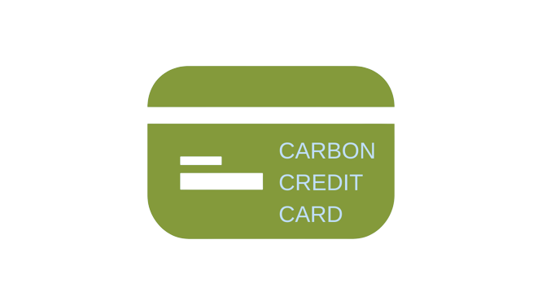
PERSONAL CARBON CREDITS
SOCIAL MEDIA USAGE
Notes:
linking this behavior with credits

Slide 13
PERSONAL CARBON CREDITS
MONTHLY FROM THE GOVERNMENT
AT THE END OF THE MONTH: PAY IF OVER-BUDGET

Slide 14
PERSONAL CARBON CREDITS
MONTHLY FROM THE GOVERNMENT
AT THE END OF THE MONTH: PAY IF OVER-BUDGET
OFFSET TO INCREASE BUDGET

Slide 15
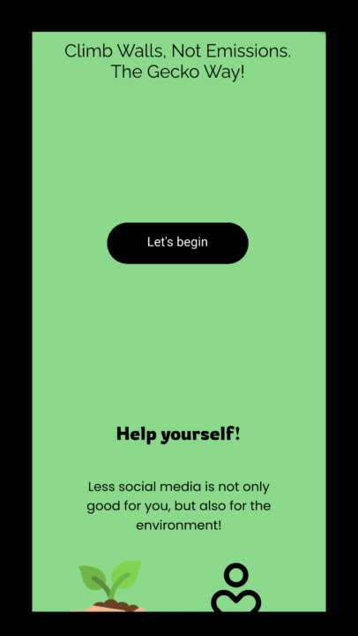

Slide 16
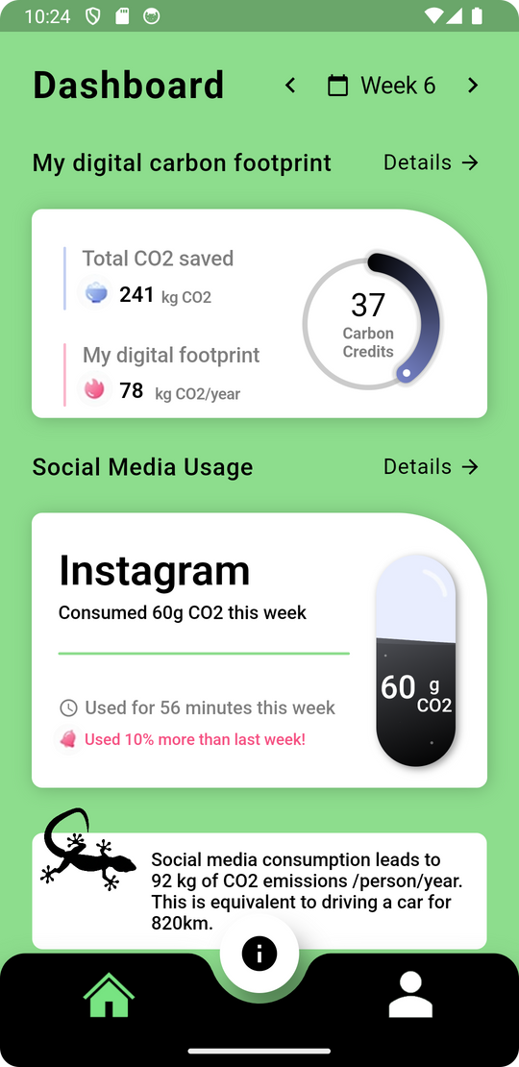
DIGITAL CARBON FOOTPRINT
PERSONAL CARBON CREDITS
KEEP TRACK OF SOCIAL MEDIA USAGE
USER-FRIENDLY & EASY UI

Slide 17
TOTAL AMOUNT OF SAVED CO2
TRACK WEEK BY WEEK
STATS COMPARISON
FACTS ABOUT ENVIRONMENTALISM

Slide 18

ALL POWERED BY
Notes:
to keep it also all things environmental-friendly
run our application on

Slide 19
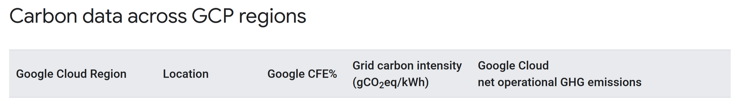
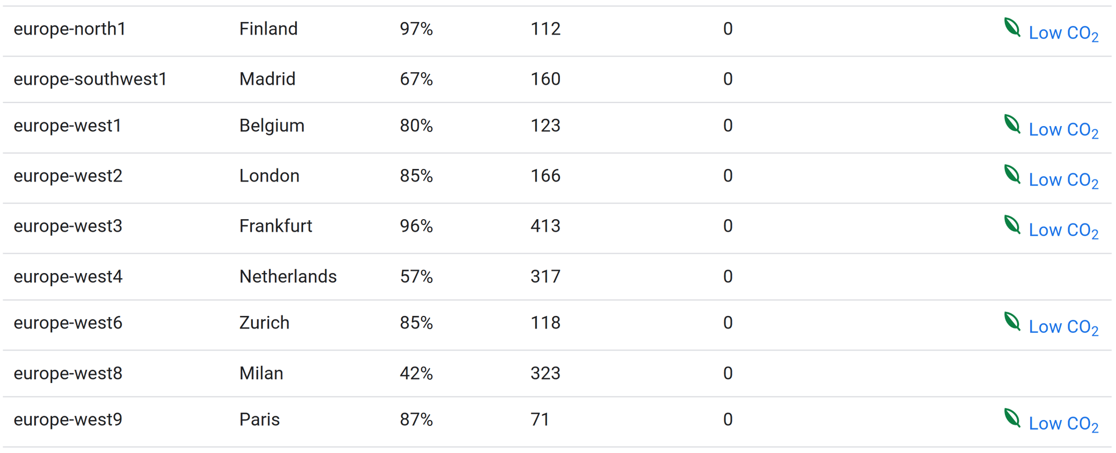

HTTPS://CLOUD.GOOGLE.COM/SUSTAINABILITY/REGION-CARBON
Notes:
google cloud
net zero

Slide 20



ENVIRONMENT
DIGITAL WELLBEING
USER-FRIENDLY

Slide 21
stick to reality.
tHE GECKO WAY.
CARBON GECKO

